Slide 1
Electronic Devices
Final Term Lecture - 01
Reference book:
Electronic Devices and Circuit Theory (Chapter-5)
Robert L. Boylestad and L. Nashelsky , (11th Edition)

Slide 2
OBJECTIVES
Become familiar with there, r_{e}, hybrid and hybrid pi models for the BJT transistor.
Learn to use the equivalent model to find the important ac parameters for an amplifier.
Understand the effects of a source resistance and load resistor on the overall gain and characteristics of an amplifier.
Become aware of the general ac characteristics of a variety of important BJT configurations.
Begin to understand the advantages associated with the two-port systems approach to single- and multistage amplifiers.
Develop some skill in troubleshooting ac amplifier networks.

Slide 3
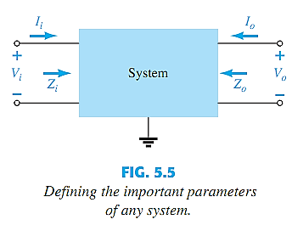
BJT TRANSISTOR MODELING
A model is an equivalent circuit that represents the AC characteristics of the transistor.
A model uses circuit elements that approximate the behavior of the transistor.
There are two models commonly used in small signal AC analysis of a transistor:
r_{e} model
Hybrid equivalent model

Slide 4
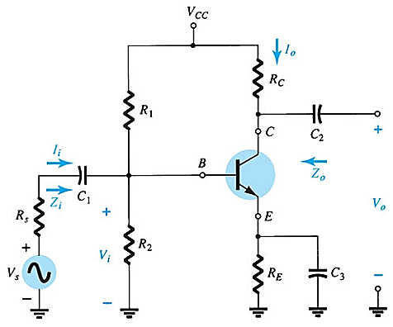
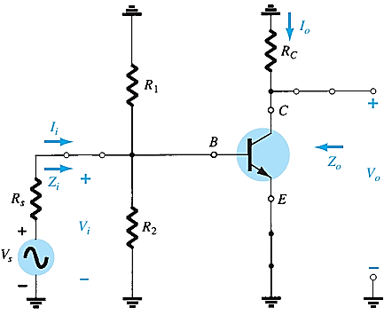
BJT TRANSISTOR MODELING
Capacitors chosen with very small reactance at the frequency of application → replaced by low-resistance or short circuit.
Removal of the dc supply and insertion of the short-circuit equivalent for the capacitors.

Slide 5
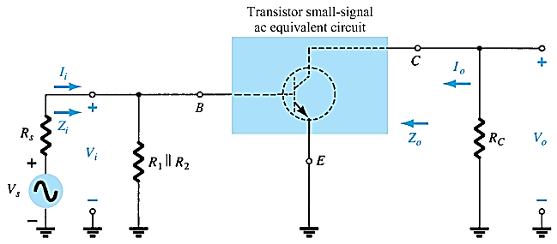
BJT TRANSISTOR MODELING
Circuit redrawn for small signal ac analysis

Slide 6
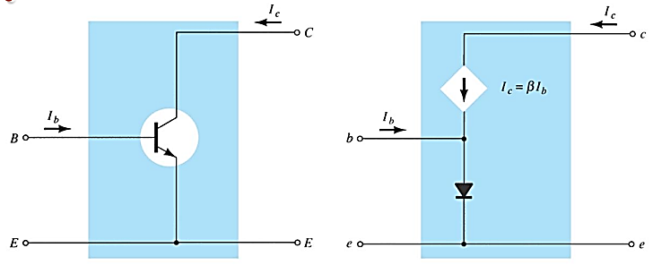
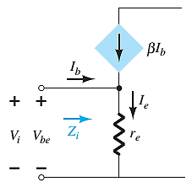
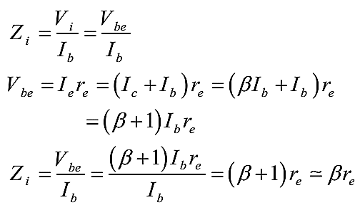
The r_{e} Transistor Model (Common Emitter Configuration)

Slide 7
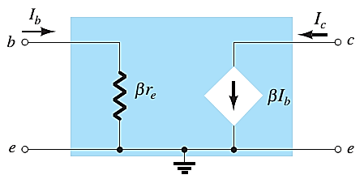
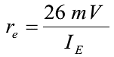
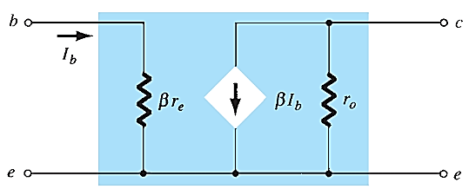
The r_{e} Transistor Model (Common Emitter Configuration)

Slide 8
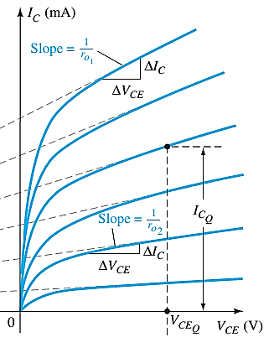
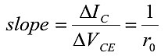
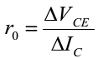
The r_{e} Transistor Model (Common Emitter Configuration)

Slide 9
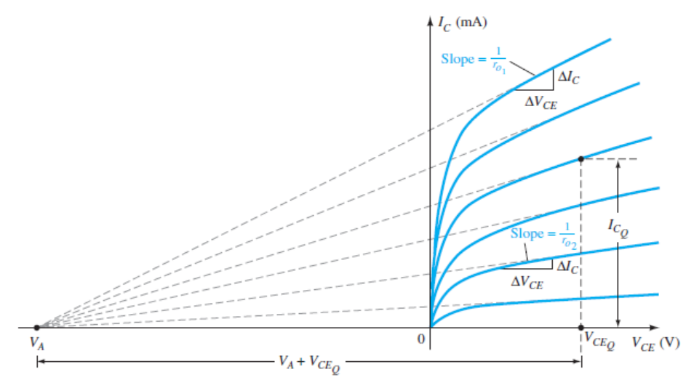
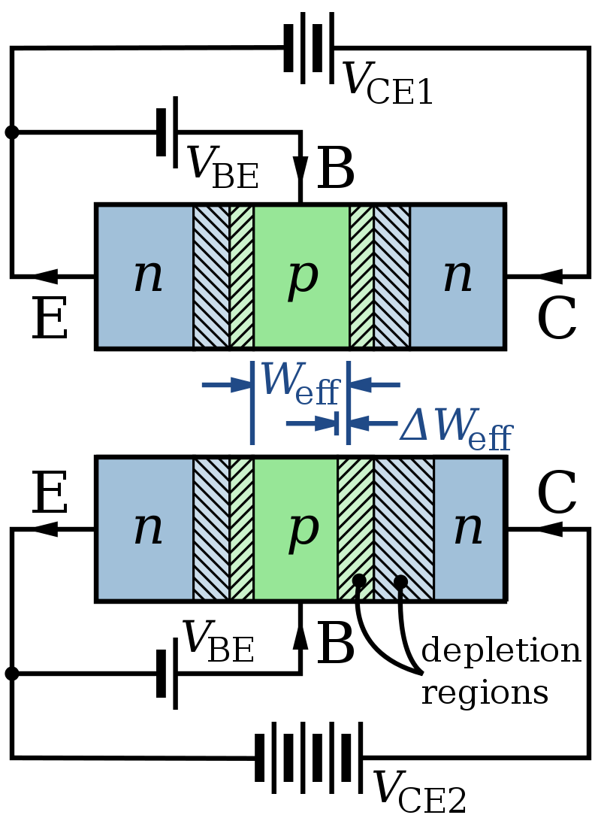
The r_{e} Transistor Model (Common Emitter Configuration)
The Early effect, named after its discoverer James M. Early, is the variation in the effective width of the base in a bipolar junction transistor (BJT) due to a variation in the applied base-to-collector voltage.
A greater reverse bias across the collector–base junction, for example, increases the collector–base depletion width, thereby decreasing the width of the charge carrier portion of the base.

Slide 10
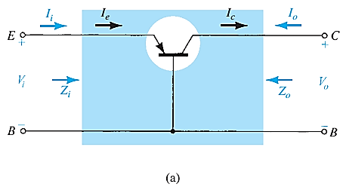
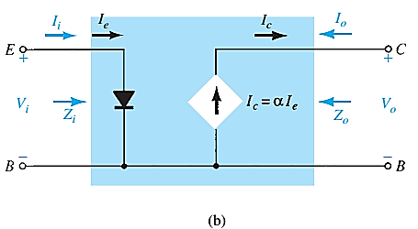
COMMON-BASE CONFIGURATION

Slide 11
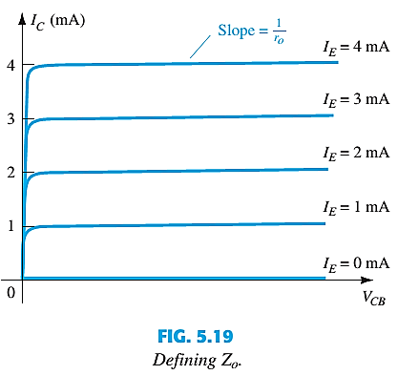
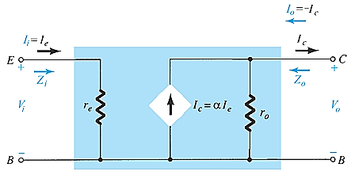
COMMON-BASE CONFIGURATION
The output resistance r₀ is quite high. typically extend into the MΩ range.
Common Base r_{e} equivalent circuit

Slide 12
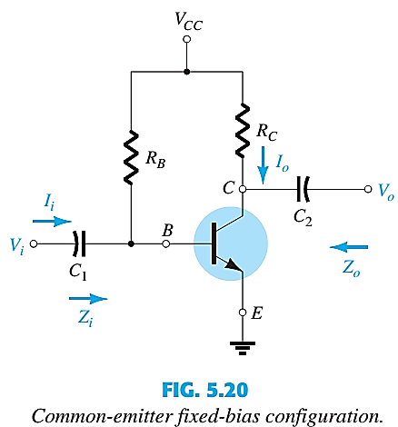
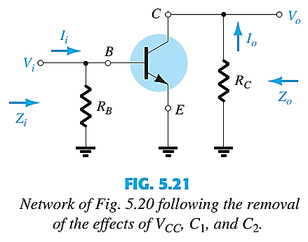
COMMON EMITTER FIXED BIAS CONFIGURATION

Slide 13
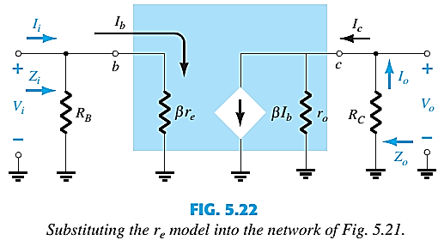
COMMON EMITTER FIXED BIAS CONFIGURATION

Slide 14
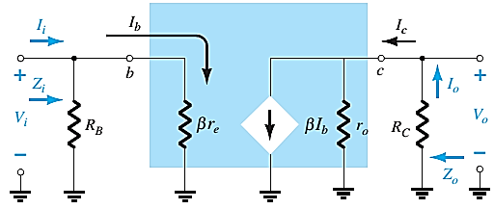
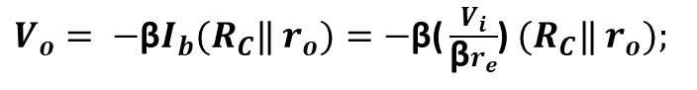
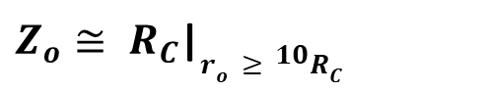
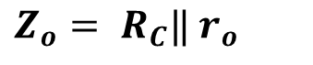
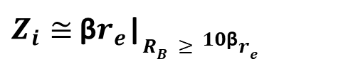
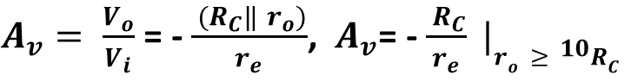
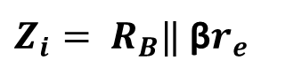
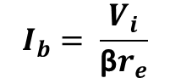
COMMON EMITTER FIXED BIAS CONFIGURATION
INPUT IMPEDANCE, Z_{i}
$Z_{i}= R_{B}‖$ β$r_{e}$
$Z_{i}≅$β$r_{e}$|$R_{B}≥10\text{β}r_{e}$
OUTPUT IMPEDANCE, Z_{o}
VOLTAGE GAIN, A_{v}
$Z_{o}= R_{C}‖$ $r_{o}$
$V_{o}= {−\text{β}I_{b}(R}_{C}‖$ $r_{o})=−\text{β}\text{(}\frac{V_{i}}{\text{β}r_{e}}$)${ (R}_{C}‖$ $r_{o});$
$$I_{b}= \frac{V_{i}}{\text{β}r_{e}}$$
$Z_{o}≅ R_{C}$|$r_{o}≥10R_{C}$
$A_{v}= \frac{V_{o}}{V_{i}}$ = - $\frac{{ (R}_{C}‖ r_{o})}{r_{e}}$, ${ A}_{v}$= - $\frac{{ R}_{C}}{r_{e}} |r_{o}≥10R_{C}$
For the majority of situations R B is greater than b r e by more than a factor of 10

Slide 15
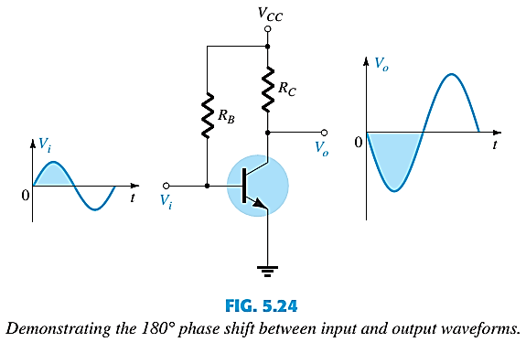
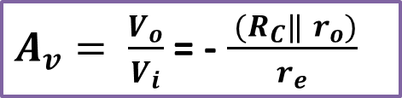
COMMON EMITTER FIXED BIAS PHASE RELATIONSHIP
$A_{v}= \frac{V_{o}}{V_{i}}$ = - $\frac{{ (R}_{C}‖ r_{o})}{r_{e}}$
Demonstrating the 180° phase shift between input and output waveforms.
Why is transistor output inverted?
The inversion is because of the direction of the current source is the reverse of the vbe, so an increase in vbe results in decrease of vce

Slide 16
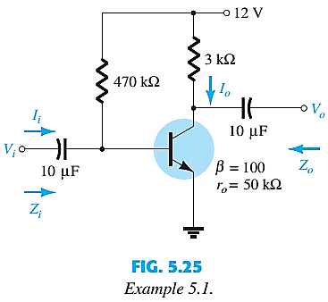
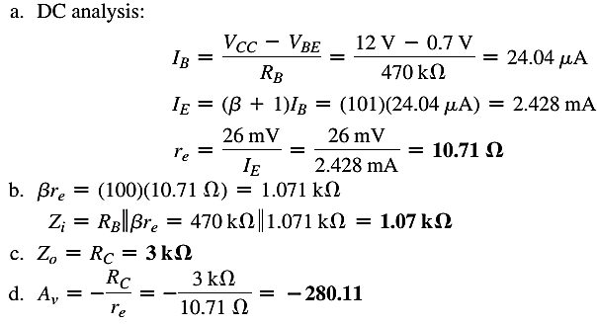
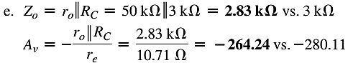
EXAMPLE
EXAMPLE 5.1: For the network of Fig. 5.25 :
Determine r_{e}, Z_{i} (with r_{o} = ∞), Z_{o} (with r_{o} = ∞), A_{v} (with r_{o} = ∞) and Repeat with r_{o} = 50 kΩ.

Slide 17
End of Lecture-1

Slide 18
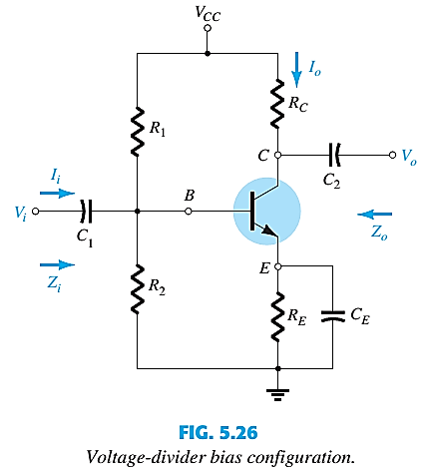
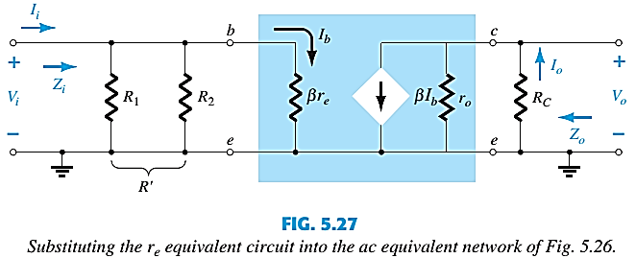
COMMON-EMITTER VOLTAGE-DIVIDER BIAS

Slide 19
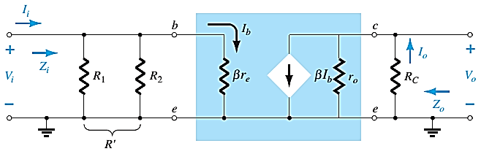
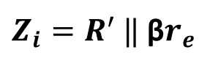
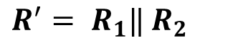
COMMON-EMITTER VOLTAGE-DIVIDER BIAS
INPUT IMPEDANCE, Z_{i}
$R^{′}= R_{1}‖$ $R_{2}$
$Z_{i}=R^{′}$ $‖$β$r_{e}$
OUTPUT IMPEDANCE, Z_{o}
VOLTAGE GAIN, A_{v}
$Z_{o}= R_{C}‖$ $r_{o}$
$V_{o}= {−\text{β}I_{b}(R}_{C}‖$ $r_{o})=−\text{β}\text{(}\frac{V_{i}}{\text{β}r_{e}}$)${ (R}_{C}‖$ $r_{o});$
$$I_{b}= \frac{V_{i}}{\text{β}r_{e}}$$
$Z_{o}≅ R_{C}$|$r_{o}≥10R_{C}$
$A_{v}= \frac{V_{o}}{V_{i}}$ = - $\frac{{ (R}_{C}‖ r_{o})}{r_{e}}$, ${ A}_{v}$= - $\frac{{ R}_{C}}{r_{e}} |r_{o}≥10R_{C}$

Slide 20
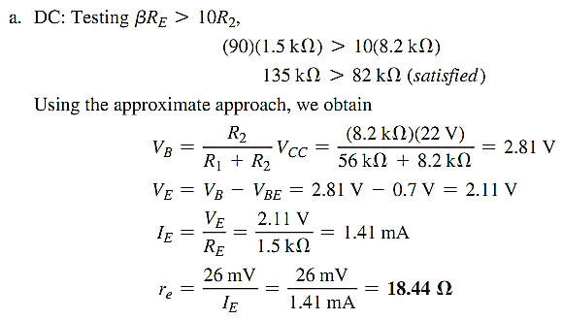
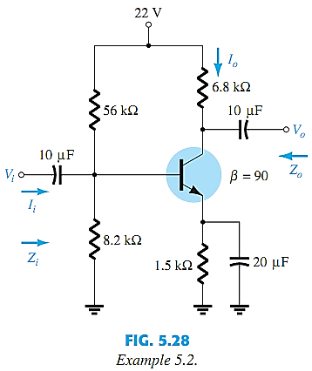
EXAMPLE
EXAMPLE 5.2: For the network of Fig. 5.28 :
Determine r_{e}, Z_{i}, Z_{o} (with r_{o} = ∞), A_{v} (with r_{o} = ∞) and Repeat with r_{o} = 50 kΩ.

Slide 21
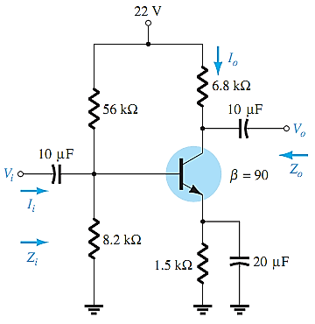
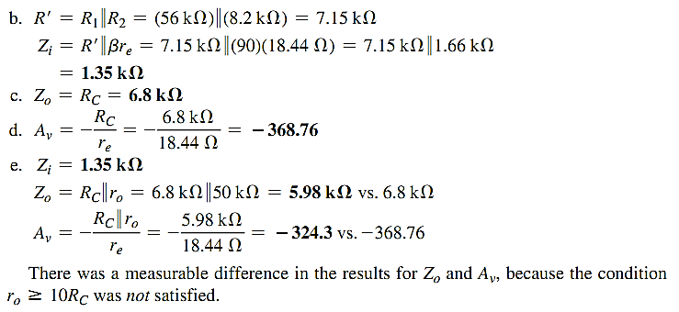
EXAMPLE Contd.

Slide 22
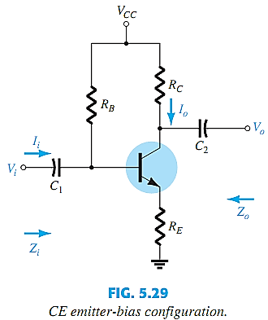
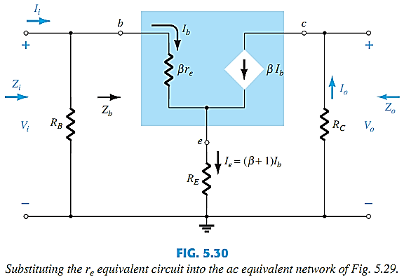
COMMON-EMITTER EMITTER-BIAS CONFIGURATION: UNBYPASSED R_{E}

Slide 23
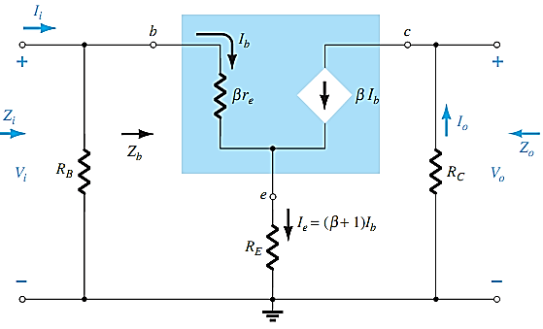
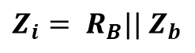
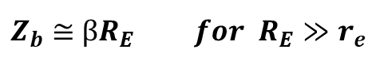
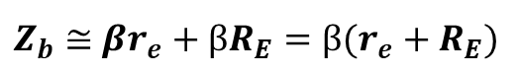



IMPEDANCE CALCULATION
INPUT IMPEDANCE, Z_{i}
$V_{i}= I_{b}βr_{e}+I_{e}R_{E}$
= $I_{b}βr_{e}+{(β+1)I}_{b}R_{E}$
$Z_{b}=$ $\frac{V_{i}}{I_{b}}=βr_{e}+{(β+1)R}_{E}$
$Z_{b}≅$ $βr_{e}+{βR}_{E}=β(r_{e}+R_{E})$
$Z_{b}≅$ ${βR}_{E} for{ R}_{E}≫r_{e}$
$Z_{i}= R_{B}||$ $Z_{b}$
OUTPUT IMPEDANCE, Z_{o}
$$Z_{o}= R_{C}$$

Slide 24






GAIN CALCULATIONS
VOLTAGE GAIN, A_{v}
$V_{o}=−I_{o}R_{C}=− βI_{b}R_{C}$ = $− β$($\frac{V_{i}}{Z_{b}}$) $R_{C}$
$A_{v}= \frac{V_{o}}{V_{i}}$ = - $\frac{βR_{C}}{Z_{b}}$
${Substituting Z}_{b}≅$ $β(r_{e}+R_{E})$
$A_{v}= \frac{V_{o}}{V_{i}}$ = - $\frac{R_{C}}{r_{e}+R_{E}}$
${For the approximation Z}_{b}≅$ $βR_{E}$
$A_{v}= \frac{V_{o}}{V_{i}}$ = - $\frac{R_{C}}{R_{E}}$
The negative sign in gain equations reveals 180° phase shift between input and output waveforms.

Slide 25

COMMON-EMITTER EMITTER-BIAS CONFIGURATION: BYPASSED R_{E}
Bypassed
If R_{E} is bypassed by an emitter capacitor C_{E}, the complete r_{e} equivalent model can be substituted, resulting in the same equivalent network as Fig. 5.22. Equations of slide no. 13 are therefore applicable.

Slide 26


EXAMPLE
EXAMPLE 5.3: For the network of following Fig, without C_{E} (unbypassed), determine: r_{e}, Z_{i}, Z_{o} & A_{v.}

Slide 27



EXAMPLE Contd.

Slide 28


EMITTER-FOLLOWER CONFIGURATION
This is also known as the common-collector configuration.
The input is applied to the base and the output is taken from the emitter.
There is no phase shift between input and output.

Slide 29





IMPEDANCE CALCULATIONS
INPUT IMPEDANCE, Z_{i}
$Z_{i}= R_{B}||$ $Z_{b}$
$$Z_{b}=βr_{e}+{(β+1)R}_{E}$$
$Z_{b}≅$ $β(r_{e}+R_{E})$
$Z_{b}≅$ ${βR}_{E} for{ R}_{E}≫r_{e}$

Slide 30


IMPEDANCE CALCULATIONS
OUTPUT IMPEDANCE, Z_{o}
$$I_{b}= \frac{V_{i}}{Z_{b}} ,$$
$$I_{E}=\left(β+1\right)I_{b}=\left(β+1\right)\frac{V_{i}}{Z_{b}}$$
$$I_{E}= \frac{\left(β+1\right)V_{i}}{βr_{e}+{(β+1)R}_{E}}$$
$Since (β+1)$ $≅ β$
$$I_{E}= \frac{V_{i}}{r_{e}+R_{E}}$$
$$To determine Z_{o},{ V}_{i} is set to zero$$
$Z_{o}$= $R_{E}$|| $r_{e}$ $Z_{o}$= $r_{e}$ |$R_{E}$ $≫r_{e}$

Slide 31




GAIN CALCULATIONS
VOLTAGE GAIN, A_{v}
$$V_{o}=I_{e}R_{E}=\left(β+1\right)I_{b}R_{E}=\frac{V_{i}\left(β+1\right)R_{E}}{Z_{b}}$$
$when r_{o}≥10R_{E}$ and $β+1≅β$
$$But Z_{b}≅β(r_{e}+R_{E})$$
$$A_{v}=\frac{V_{o}}{V_{i}}≅\frac{βR_{E}}{β(r_{e}+R_{E})}≅\frac{R_{E}}{(r_{e}+R_{E})}$$
See Example 5.7

Slide 32


COMMON-BASE CONFIGURATION
The input is applied to the emitter.
The output is taken from the collector.
Low input impedance.
High output impedance.
Very high voltage gain.
No phase shift between input and output.

Slide 33











CALCULATIONS
INPUT IMPEDANCE, Z_{i}
$Z_{i}= R_{E}‖$ $r_{e}$
OUTPUT IMPEDANCE, Z_{o}
$$Z_{o}= R_{C}$$
CURRENT GAIN, A_{i}
VOLTAGE GAIN, A_{v}
$Assuming R_{E}≫$ $r_{e}$
$$I_{e}= \frac{V_{i}}{r_{e}}$$
$I_{e}=$ $I_{i}$
$V_{o}= {−I_{o}R}_{C} =−{\left(I_{C}\right)R}_{C}=α{I_{e}R}_{C}$ ;
$I_{o}=−$ $αI_{e}=−$ $αI_{i}$
$V_{o}= α \left(\frac{V_{i}}{r_{e}}\right)R_{C}$ ;
$A_{v}= \frac{V_{o}}{V_{i}}$ = $\frac{{ αR}_{C}}{r_{e}}≅\frac{{ R}_{C}}{r_{e}}$
$$A_{i}=\frac{I_{o}}{I_{i}}=−α≅−1$$

Slide 34

COMMON-BASE CONFIGURATION
Phase Relationship:
The fact that A_{v} is a positive number shows that V_{o} and V_{i} are in phase for the common-base configuration.
Effect of r_{o} :
For the common-base configuration, r_{o} = 1/h_{ob} is typically in the megohm range and sufficiently larger than the parallel resistance R_{C} to permit the approximation r_{o} || R_{C} $≅$R_{C}.

Slide 35


EXAMPLE
EXAMPLE 5.8: For the network of following figure, determine: r_{e}, Z_{i}, Z_{o}, A_{v}, A_{i}.

Slide 36
End of Lecture-2

Slide 37
FETs vs BJTs
FET’s (Field – Effect Transistors) are much like BJT’s (Bipolar Junction Transistors).
Similarities:
Amplifiers
Switching devices
Impedance matching circuits
Differences:
FET’s are voltage controlled devices whereas BJT’s are current controlled devices.
FET’s are unipolar devices whereas BJT’s are bipolar devices.
FET’s also have a higher input impedance, but BJT’s have higher gains.
FET’s are less sensitive to temperature variations and because of their construction they are more easily integrated into IC’s.

Slide 38
FET TYPES
JFET: Junction Field-Effect Transistor
MOSFET: Metal-Oxide Semiconductor Field-Effect Transistor
D-MOSFET ~ Depletion type MOSFET
E-MOSFET ~ Enhancement type MOSFET

Slide 39

JFET CONSTRUCTION
There are two types of JFETs
n- channel
p- channel
The n-channel is more widely used.
There are three terminals:
Drain (D) and Source (S) are connected to n-channel
Gate (G) is connected to the p-type material
Check this: http://www-g.eng.cam.ac.uk/mmg/teaching/linearcircuits/jfet.html

Slide 40

BASIC OPERATION OF JFET
JFET operation can be compared to a water spigot.
The source of water pressure is the accumulation of electrons at the negative pole of the drain-source voltage.
The drain of the water is the electron deficiency (or holes) at the positive pole of the applied voltage.
The control of flow of water is the gate voltage that controls the width of the n channel and therefore, the flow of charges from source to drain.

Slide 41
JFET OPERATING CHARACTERISTICS
There are three basic operating conditions for a JFET:
A. V_{GS} = 0, V_{DS} increasing to some positive value
B. V_{GS} < 0, V_{DS} at some positive value
C. Voltage-Controlled Resistor

Slide 42

JFET OPERATING CHARACTERISTICS: V_{GS} = 0 V
Three things happen when V_{GS} = 0 and V_{DS} is increased from 0 to a more positive voltage:
The depletion region between p-gate and n-channel increases as electrons from n-channel combine with holes from p-gate.
Increasing the depletion region, decreases the size of the n-channel which increases the resistance of the n-channel.
But even though the n-channel resistance is increasing, the current (I_{D}) from Source to Drain through the n-channel is increasing. This is because V_{DS} is increasing.

Slide 43

JFET OPERATING CHARACTERISTICS: V_{GS} = 0 V
It is important to note that the depletion region is wider near the top of both p-type Materials.
Assuming a uniform resistance in the n-channel, the resistance of the channel can be broken down to the divisions appearing in Figure.
The current I_{D} will establish the voltage levels through the channel as indicated on the same figure. The result is that the upper region of the p-type material will be reverse biased by about 1.5 V, with the lower region only reverse-biased by 0.5 V.
The greater the applied reverse bias, the wider the depletion region—hence the distribution of the depletion region as shown in figure. The fact that the p-n junction is reverse-biased for the length of the channel results in a gate current of zero amperes.

Slide 44

PINCH-OFF
If V_{GS} = 0 and V_{DS} is further increased to a more positive voltage, then the depletion zone gets so large that it pinches off the n-channel.
This suggests that the current in the n-channel (I_{D}) would drop to 0A, but it does just the opposite: as V_{DS} increases, so does I_{D}.

Slide 45

SATURATION
At the pinch-off point:
Any further increase in V_{DS} does not produce any increase in I_{D}. V_{DS} at pinch-off is denoted as V_{p}.
I_{D} is at saturation or maximum. It is referred to as I_{DSS}.
The ohmic value of the channel is at maximum.

Slide 46

I_{D} < I_{DSS}
As V_{GS} becomes more negative:
The JFET will pinch-off at a lower value of V_{DS}.
I_{D} decreases (I_{D} < I_{DSS}) even though V_{DS} is increased.
Eventually I_{D} will reach 0A. V_{GS} at this point is called V_{p} or V_{GS(off).}
Also note that at high levels of V_{DS} the JFET reaches a breakdown situation. I_{D} will increases uncontrollably if V_{DS} > V_{DSmax}.

Slide 47


JFET OPERATING CHARACTERISTICS: VOLTAGE CONTROLLED RESISTOR
The region to the left of the pinch-off point is called the ohmic region.
The JFET can be used as a variable resistor, where V_{GS} controls the drain-source resistance (r_{d}).
The slope of each curve and therefore the resistance of the device between drain and source for V_{DS} < V_{P} is a function of the applied voltage V_{GS.}
As V_{GS} becomes more negative, the resistance (r_{d}) increases.

Slide 48

P-CHANNEL JFETS
p-Channel JFET acts the same as the n-channel JFET, except the polarities and currents are reversed.

Slide 49
Electronic Devices
Final Term Lecture - 04
Reference book:
Electronic Devices and Circuit Theory (Chapter-6)
Robert L. Boylestad and L. Nashelsky , (11th Edition)

Slide 50

P-CHANNEL JFET CHARACTERISTICS
As V_{GS} increases more positively:
The depletion zone increases
I_{D} decreases (I_{D} < I_{DSS})
Eventually I_{D} = 0A
Also note that at high levels of V_{DS} the JFET reaches a breakdown situation. I_{D} increases uncontrollably if V_{DS} > V_{DSmax}.

Slide 51

JFET SYMBOLS

Slide 52
SUMMARY TILL NOW
The maximum current is defined as I_{DSS} and occurs when V_{GS} = 0 V and V_{DS} ≥ |V_{p}|, as shown in Fig. 6.15a .
For gate-to-source voltages V_{GS} is less than (more negative than) the pinch-off level, the drain current is 0 A (I_{D} = 0 A ), as in Fig. 6.15b .
For all levels of V_{GS} between 0 V and the pinch-off level, the current I_{D} will range between I_{DSS} and 0 A, respectively, as in Fig. 6.15c.
A similar list can be developed for p-channel JFETs.

Slide 53




SUMMARY TILL NOW

Slide 54

JFET TRANSFER CHARACTERISTICS
The transfer characteristic of input-to-output is not as straight forward in a JFET as it was in a BJT.
In a BJT, β indicated the relationship between I_{B} (input) and I_{C} (output).
In a JFET, the relationship of V_{GS} (input) and I_{D} (output) is a little more complicated (Shockley’s equation):

Slide 55

TRANSFER CURVE

Slide 56
PLOTTING THE TRANSFER CURVE
Using I_{DSS} and V_{p} (V_{GS(off)}) values found in a specification sheet, the Transfer Curve can be plotted using these 3 steps:
Step 1:
Solving for V_{GS} = 0V:
Step 2:
Solving for V_{GS} = V_{p} (V_{GS(off)}):
Step 3:
Solving for V_{GS} = 0V to V_{p}:

Slide 57
SHORTHAND METHOD
V_{GS} | I_{D}
0 | I_{DSS}
0.3V_{P} | I_{DSS}/2
0.5V_{P} | I_{DSS}/4
V_{P} | 0mA
When VGS = 0 V, ID = IDSS
When VGS = VP, ID = 0 mA

Slide 58


EXAMPLE

Slide 59


EXAMPLE

Slide 60

MOSFETs
MOSFETs have characteristics similar to JFETs and additional characteristics that make them very useful.
There are 2 types:
Depletion-Type MOSFET
Enhancement-Type MOSFET

Slide 61

ENHANCEMENT-TYPE MOSFET CONSTRUCTION
The Drain (D) and Source (S) connect to the to n-doped regions.
The Gate (G) connects to the p-doped substrate via a thin insulating layer of SiO2.
There is no channel. The n-doped material lies on a p-doped substrate that may have an additional terminal connection called SS.
In summary, therefore, the construction of an enhancement-type MOSFET is quite similar to that of the depletion-type MOSFET, except for the absence of a channel between the drain and source terminals.

Slide 62

CONTINUED…
As V_{GS} increases in magnitude, the concentration of electrons near the SiO2 surface increases until eventually the induced n-type region can support a measurable flow between drain and source.
The level of V_{GS} that results in the significant increase in drain current is called the threshold voltage and is given the symbol V_{T}.
Since the channel is nonexistent with V_{GS}=0 V and “enhanced” by the application of a positive gate-to-source voltage, this type of MOSFET is called an enhancement-type MOSFET.

Slide 63

CONTINUED…
As V_{GS} is increased beyond the threshold level, the density of free carriers in the induced channel will increase, resulting in an increased level of drain current.
However, if we hold V_{GS} constant and increase the level of V_{DS}, the drain current will eventually reach a saturation level The levelling off of I_{D} is due to a pinching-off process depicted by the narrower channel at the drain end of the induced channel.
By applying KVL we get –
If V_{GS} is held fixed at some value such as 8 V and V_{DS} is increased from 2 to 5V, the voltage will drop from -6 to -3 V. This reduction in gate-to-drain voltage will in turn reduce the attractive forces for free carriers (electrons) in this region of the induced channel, causing a reduction in the effective channel width.
Eventually, the channel will be reduced to the point of pinch-off and a saturation condition will be established.

Slide 64

CONTINUED…

Slide 65

BASIC OPERATION
The Enhancement-type MOSFET only operates in the enhancement mode.
V_{GS} is always positive.
As V_{GS} increases, I_{D} increases.
But if V_{GS} is kept constant and V_{DS} is increased, then I_{D} saturates (I_{DSS}).
The saturation level, V_{DSsat} is reached.
Check this: http://www-g.eng.cam.ac.uk/mmg/teaching/linearcircuits/jfet.html

Slide 66
End of Lecture-4

Slide 67
TRANSFER CURVE
To determine I_{D} given V_{GS}:
where V_{T} = threshold voltage or voltage at which the MOSFET turns on.
k = constant found in the specification sheet
k can also be determined by using values at a specific point and the formula:
V_{DSsat} can also be calculated:

Slide 68

P -CHANNEL ENHANCEMENT-TYPE MOSFETS
The p-channel Enhancement-type MOSFET is similar to the n-channel except that the voltage polarities and current directions are reversed.

Slide 69

SYMBOLS

Slide 70

DEPLETION-TYPE MOSFET CONSTRUCTION
The Drain (D) and Source (S) connect to the to n-doped regions.
These N-doped regions are connected via an n-channel. This n-channel is connected to the Gate (G) via a thin insulating layer of SiO2.
The n-doped material lies on a p-doped substrate that may have an additional terminal connection called SS.

Slide 71

BASIC OPERATION
In Fig. 6.25 the gate-to-source voltage is set to 0 V by the direct connection from one terminal to the other, and a voltage V_{DD} is applied across the drain-to-source terminals.
The result is an attraction of the free electrons of the n-channel for the positive voltage at the drain.
The result is a current similar to that flowing in the channel of the JFET. In fact, the resulting current with V_{GS} = 0 V continues to be labeled I_{DSS.}

Slide 72

BASIC OPERATION
A Depletion MOSFET can operate in two modes: Depletion or Enhancement mode.

Slide 73

BASIC OPERATION CONTD.
In this figure V_{GS} has been set at a negative voltage such as 1 V. The negative potential at the gate will tend to pressure electrons toward the p-type substrate (like charges repel) and attract holes from the p-type substrate (opposite charges attract).
Depending on the magnitude of the negative bias established by V_{GS}, a level of recombination between electrons and holes will occur that will reduce the number of free electrons in the n-channel available for conduction. The more negative the bias, the higher the rate of recombination.
The resulting level of drain current is therefore reduced with increasing negative bias for V_{GS} for V_{GS} =1 V, 2 V, and so on, to the pinch-off level of 6 V. The resulting levels of drain current and the plotting of the transfer curve proceeds exactly as described for the JFET.

Slide 74
DEPLETION-TYPE MOSFET IN DEPLETION MODE
Depletion mode:
The characteristics are similar to the JFET.
When V_{GS} = 0V, I_{D} = I_{DSS}
When V_{GS} < 0V, I_{D} < I_{DSS}
The formula used to plot the Transfer Curve still applies:

Slide 75
ENHANCEMENT MODE
For positive values of V_{GS}, the positive gate will draw additional electrons (free carriers) from the p-type substrate due to the reverse leakage current and establish new carriers through the collisions resulting between accelerating particles.
As the gate-to-source voltage continues to increase in the positive direction, the drain current will increase at a rapid rate.
The application of a positive gate-to-source voltage has “enhanced” the level of free carriers in the channel compared to that encountered with V_{GS} =0 V. For this reason the region of positive gate voltages on the drain or transfer characteristics is often referred to as the enhancement region,
The region between cutoff and the saturation level of I_{DSS} referred to as the depletion region.

Slide 76
DEPLETION-TYPE MOSFET IN ENHANCEMENT MODE
Enhancement mode:
V_{GS} > 0V, I_{D} increases above I_{DSS.}
The formula used to plot the Transfer Curve still applies:
(note that V_{GS} is now a positive polarity)

Slide 77

P-CHANNEL DEPLETION-TYPE MOSFET
The p-channel Depletion-type MOSFET is similar to the n-channel except that the voltage polarities and current directions are reversed.

Slide 78

SYMBOLS

Slide 79

SUMMARY TABLE

Slide 80

MOSFET HANDLING
MOSFETs are very static sensitive. Because of the very thin SiO2 layer between the external terminals and the layers of the device, any small electrical discharge can stablish an unwanted conduction.
Protection:
Always transport in a static sensitive bag.
Always wear a static strap when handling MOSFETS.
Apply voltage limiting devices between the Gate and Source, such as back-to-back Zeners to limit any transient voltage.

Slide 81

CMOS
CMOS – Complementary MOSFET p-channel and n-channel MOSFET on the same substrate.
Advantage:
Useful in logic circuit designs
Higher input impedance
Faster switching speeds
Lower operating power levels
Application:
CMOS Inverter

Slide 82

CMOS INVERTER
An inverter is a logic element that “inverts” the applied signal. That is, if the logic levels of operation are 0V (0-state) and 5V (1-state), an input level of 0V will result in an output level of 5V, and vice versa.
Here, both gates are connected to the applied signal and both drain to the output V_{o}. The source of the p-channel MOSFET (Q₂) is connected directly to the applied voltage V_{SS}, while the source of the n-channel MOSFET (Q₁) is connected to ground.
Here, the application of 5V at the input should result in approximately 0 V at the output. With 5V at V_{i} (with respect to ground), V_{GS1} = V_{i} and Q₁ is “on,” resulting in a relatively low resistance between drain and source.
Since V_{i} and V_{SS} are at 5 V, V_{GS2} = 0 V, which is less than the required V_{T} for the device, resulting in an “off” state. The resulting resistance level between drain and source is quite high for Q₂.

Slide 83

CMOS INVERTER
A simple application of the voltage-divider rule will reveal that V_{o} is very close to 0 V or the 0-state, establishing the desired inversion process.
For an applied voltage V_{i} of 0V (0-state), V_{GS1} = 0V and Q₁ will be off with V_{SS2} =-5V, turning on the p-channel MOSFET. The result is that Q₂ will present a small resistance level, Q₁ a high resistance, and V_{o} =V_{SS} =5 V (the 1-state).

Slide 84
End of Lecture-5

Slide 85
OBJECTIVES
Be able to perform a dc analysis of JFET, MOSFET, and MESFET networks.
Become proficient in the use of load-line analysis to examine FET networks.
Develop confidence in the dc analysis of networks with both FETs and BJTs.
Understand how to use the Universal JFET Bias Curve to analyze the various FET configurations.

Slide 86
GENERAL RELATIONSHIPS
For all FETs:
For JFETs and Depletion-Type MOSFETs:
For Enhancement-Type MOSFETs:
BJT: Linear Relationship between I_{B} and I_{C}
FET: Non-linear Relationship between V_{GS} and I_{D}.

Slide 87
COMMON FET BIASING CIRCUITS
JFET
Fixed – Bias
Self-Bias
Voltage-Divider Bias
Depletion-Type MOSFET
Self-Bias
Voltage-Divider Bias
Enhancement-Type MOSFET
Feedback Configuration
Voltage-Divider Bias

Slide 88

FIXED-BIAS JFET
The simplest biasing arrangements:
For the DC analysis,
Capacitors are open circuits
The zero-volt drop across R_{G} permits replacing R_{G} by a short-circuit.

Slide 89


FIXED-BIAS JFET
Can be solved using either Mathematical Approach or Graphical Approach:
Mathematical Approach
Graphical Approach

Slide 90



FIXED-BIAS JFET EXAMPLE
Determine V_{GSQ}, I_{DQ}, V_{DS}, V_{D}, V_{G}, V_{S}.

Slide 91


FIXED-BIAS JFET EXAMPLE
Graphical Approach
V_{GS} | I_{D}
0 | I_{DSS}
0.3V_{P} | I_{DSS}/2
0.5V_{P} | I_{DSS}/4
V_{P} | 0mA

Slide 92


JFET: SELF-BIAS CONFIGURATION
The self-bias configuration eliminates the need for two dc supplies.

Slide 93

SELF-BIAS CONFIGURATION
Can be solved using either Mathematical Approach or Graphical Approach:

Slide 94
SELF-BIAS CONFIGURATION
Graphical Approach
Draw the device transfer characteristic using shorthand method.
Draw the network load line
Use to draw straight line.
First point,
Second point, any point from I_{D} = 0 to I_{D} = I_{DSS}. Choose
The Q-point obtained at the intersection of the straight line plot and the device characteristic curve.
The quiescent value for I_{D} and V_{GS} can then be determined and used to find the other quantities of interest.

Slide 95


SELF-BIAS CONFIGURATION

Slide 96





SELF-BIAS EXAMPLE
Determine V_{GSQ}, I_{DQ},V_{DS},V_{S},V_{G} and V_{D}.

Slide 97

SELF-BIAS EXAMPLE Contd.
Plot I_{D} vs V_{GS} and draw a line from the origin of the axis.

Slide 98
End of Lecture-6

Slide 99

SELF-BIAS EXAMPLE Contd.
Plot the transfer curve using I_{DSS} and V_{P} using shorthand method:
V_{GS} | I_{D}
0 | I_{DSS}
0.3V_{P} | I_{DSS}/2
0.5V_{P} | I_{DSS}/4
V_{P} | 0mA

Slide 100





SELF-BIAS EXAMPLE Contd.
Superimpose the load line on top of the transfer curve:

Slide 101

JFET: VOLTAGE-DIVIDER BIAS
The source V_{DD} was separated into two equivalent sources to permit a further separation of the input and output regions of the network.
Since I_{G} = 0A, Kirchoff’s current law requires that I_{R1}= I_{R2} and the series equivalent circuit appearing to the left of the figure can be used to find the level of V_{G}.

Slide 102

VOLTAGE-DIVIDER BIAS
V_{G} can be found using the voltage divider rule:
Using Kirchoff’s Law on the input loop:
Rearranging and using I_{D} =I_{S}:
Again the Q point needs to be established by plotting a line that intersects the transfer curve.

Slide 103

VOLTAGE-DIVIDER BIAS
Graphical Approach ( to find V_{GSQ} and I_{DQ}):
Plot a line for:
V_{GS} = V_{G} when I_{D} = 0A
V_{GS} = 0V when I_{D} = V_{G}/R_{S}.
Plot the transfer curve using I_{DSS} and V_{P} using shorthand method.
The Q-point is located at the intersection.
V_{GS} | I_{D}
0 | I_{DSS}
0.3V_{P} | I_{DSS}/2
0.5V_{P} | I_{DSS}/4
V_{P} | 0mA

Slide 104

EFFECT OF INCREASING VALUES OF R_{S}

Slide 105

JFET: VOLTAGE-DIVIDER BIAS EXAMPLE
Determine I_{DQ}, V_{GSQ}, V_{D}, V_{S}, V_{DS} and V_{DG}.

Slide 106

VOLTAGE-DIVIDER BIAS EXAMPLE Contd.
Graphical Approach ( to find V_{GSQ} and I_{DQ}):
Plot a line for:
V_{GS} = V_{G} when I_{D} = 0A
V_{GS} = 0V when I_{D} = V_{G}/R_{S}.
Plot the transfer curve using I_{DSS} and V_{P} using shorthand method.
Identify the Q-point.

Slide 107

D-MOSFET SELF-BIAS
D-MOSFET bias circuits are similar to JFETs.
The only difference is that D-MOSFETs can operate with positive values of V_{GS} and with I_{D} values that exceed I_{DSS}.

Slide 108

D-MOSFET SELF-BIAS
Graphical Approach (to find V_{GSQ} and I_{DQ}):
Plot the transfer curve using I_{DSS} and V_{P} using shorthand method.
Plot I_{D} vs V_{GS} using V_{GS} = -I_{D}R_{S}.
Take a positive value of V_{GS} and find the I_{D} value using
The Q-point is located at the intersection.

Slide 109

D-MOSFET SELF-BIAS EXAMPLE
Determine the I_{DQ}, V_{GSQ} and V_{D}.
Graphical Approach (to find V_{GSQ} and I_{DQ}):
Plot the transfer curve using I_{DSS} and V_{P} using shorthand method.
Take a positive value of V_{GS} and find the I_{D} value using
Plot I_{D} vs V_{GS} using V_{GS} = -I_{D}R_{S}.
Identify the intersection Q-point.

Slide 110

D-MOSFET SELF-BIAS EXAMPLE
V_{GSQ} = -4.3 V
I_{DQ} = 1.7 mA
V_{D} = 9.46 V

Slide 111

D-MOSFET VOLTAGE-DIVIDER BIAS
D-MOSFET bias circuits are similar to JFETs.

Slide 112

D-MOSFET VOLTAGE-DIVIDER BIAS
Graphical Approach (to find V_{GSQ} and I_{DQ}):
Plot the transfer curve using I_{DSS} and V_{P} using shorthand method.
Take a positive value of V_{GS} and find the I_{D} value using
Plot I_{D} vs V_{GS} using V_{GS} = V_{G} - I_{D}R_{S}.
The Q-point is located at the intersection.

Slide 113
End of Lecture-7

Slide 114



E-MOSFET VOLTAGE-DIVIDER BIAS
E-MOSFETs use the same procedure to JFETs and D-MOSFETs.

Slide 115

E-MOSFET VOLTAGE-DIVIDER BIAS
Graphical Approach:
Calculate the value for
Plot V_{GS} vs I_{D} using
Plot for:
V_{GS} = V_{G} at I_{D} = 0A
V_{GS} = 0V at I_{D} = V_{G}/R_{S}
Identify the Q-point.

Slide 116




E-MOSFET VOLTAGE-DIVIDER BIAS EXAMPLE
Determine I_{D}, V_{GS}, and V_{DS} for the following network:

Slide 117



E-MOSFET VOLTAGE-DIVIDER BIAS EXAMPLE

Slide 118

E-MOSFET FEEDBACK BIAS

Slide 119

E-MOSFET FEEDBACK BIAS
Graphical Approach (to find V_{GSQ} and I_{DQ}):
Calculate the value for
Plot V_{GS} vs I_{D} for the range of interest.
Plot :
Identify the Q-point.

Slide 120


E-MOSFET FEEDBACK BIAS EXAMPLE
Example 7.10: Determine I_{DQ} and V_{DSQ} for the following circuit:

Slide 121




E-MOSFET FEEDBACK BIAS EXAMPLE CONTD.

Slide 122


E-MOSFET FEEDBACK BIAS EXAMPLE CONTD.

Slide 123
p-CHANNEL FETs
For p-channel FETs the same calculations and graphs are used, except that the voltage polarities and current directions are the opposite.
The graphs will be mirrors of the n-channel graphs.

Slide 124
End of Lecture-8

Slide 125
OBJECTIVES
Become acquainted with the small-signal ac model for a JFET and MOSFET.
Be able to perform a small-signal ac analysis of a variety of JFET and MOSFET configurations.
Begin to appreciate the design sequence applied to FET configurations.
Understand the effects of a source resistor and load resistor on the input impedance, output impedance and overall gain.
Be able to analyze cascaded configurations with FETs and/or BJT amplifiers.

Slide 126


Introduction
Field-effect transistor amplifiers provide an excellent voltage gain with the added feature of a high input impedance.
JFET Small-Signal Model
The ac analysis of a JFET Configuration requires that a small-signal ac model for the JFET be developed.
The gate-to-source voltage controls the drain-to-source (channel) current of a JFET.
The change in drain current that will result from a change in gate-to-source voltage can be determined using the transconductance factor gm in the following manner:

Slide 127


Graphical Determination of g_{m}

Slide 128




Example:

Slide 129


Mathematical Definition of g_{m}
The derivative of a function at a point is equal to the slope of the tangent line drawn at that point.

Slide 130




Example

Slide 131



Plotting g_{m} versus V_{GS}

Slide 132

Example

Slide 133




Effect of I_{D} on g_{m}

Slide 134

Example

Slide 135
End of Lecture-9

Slide 136


JFET Small Signal Model

Slide 137


JFET AC Equivalent Circuit

Slide 138


Example

Slide 139


FIXED-BIAS CONFIGURATION

Slide 140


Continued.

Slide 141




Slide 142



Slide 143



Slide 144





Slide 145
End of Lecture-10

